Slide 1
Homework 3 Findings
Olivier McNicoll
1/31/2017

Slide 2
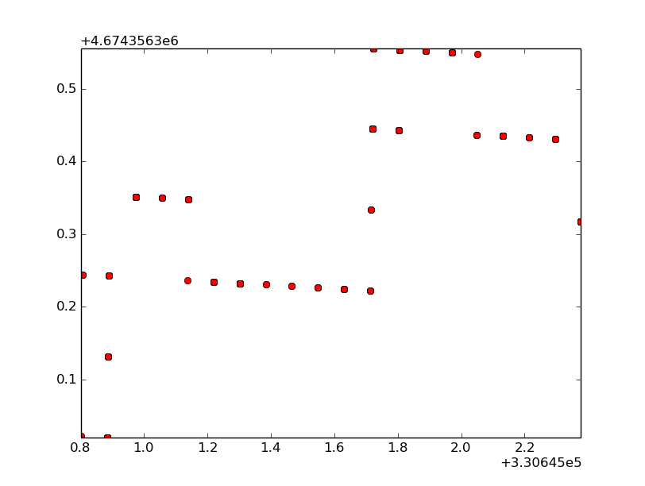
UTC X vs UTC Y
Plot of utc x vs utc y, on axis ranging from the minimum to the maximum of each value.
There seems to be distinct lines being formed between some points, may be due to satellites moving in the sky above.
Although such change in values is surprising, there is not actually that much deviation in position.

Slide 3
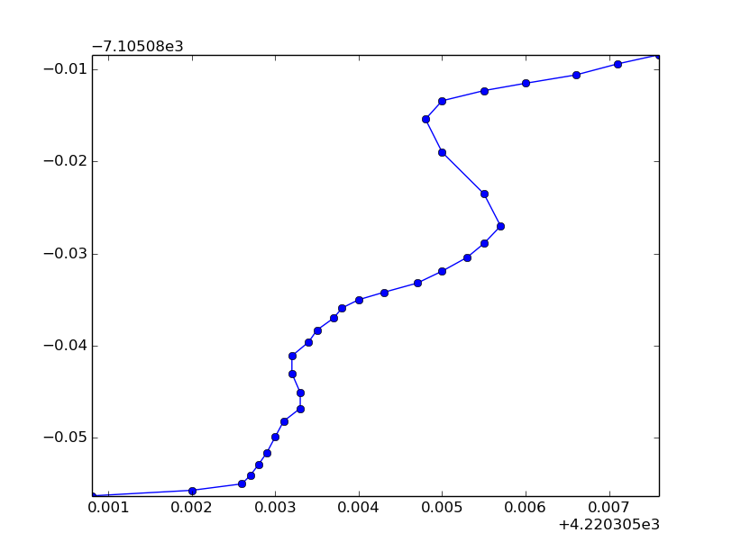
Straight Line Coordinates
Plot of GPS coordinates during my attempt to walk in a straight line.
Clearly shows either I can't walk straight, or there was some clear deviation in positioning from the GPS.

Slide 4
Some Brief Analysis
Comparing the UTC plot with the straight line plot, the deviation in my straight line looks like it could make sense.
Making a line of best fit with the data after I started walking, the GPS seems to have ended up with me in the correct location, however, like the UTC plot, it would get picked up to a different line once in a while, and then have to recalibrate.
The data was taken in the baseball field by squash busters, where I had excellent satellite reception(connected to 11/12 satellites), so the deviation in positioning could have been caused by satellites changing signal strength, and therefore my position moving slightly every time a signal got stronger or weaker, and my GPS trusted a satellites data over a different satellite.

Slide 5
Reducing Error
If I had wanted to reduce error, I could have tried to find another place that had even better satellite reception. Although I was in an open area, I was still next to some larger buildings that could obstruct signals once in a while, therefore constantly changing satellite receptions, and by association, constantly changing my location as told by the GPS

